Slide 1
TOPIC B2:
PROGRAMMING
ICA B2-8
THE ALGORACE

Slide 2
AGENDA
THE ALGORACE
NOTE!
Have a way to quickly write code based on the slides

Slide 3
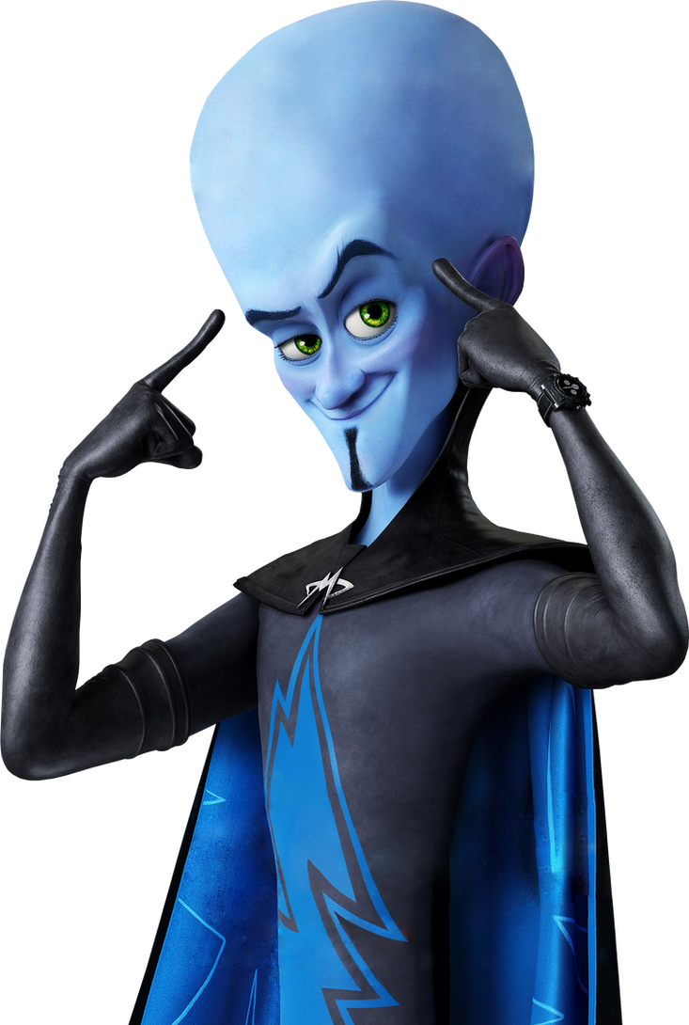
RECURSION
Today, we’ll be working through a rapid-fire set of programming problems in Python
We’ll test and build your knowledge of selection statements, loops, and procedures
You will look like this guy when you’re done
(hopefully not blue tho)

Slide 4


CHALLENGE 1
To start, let’s take it slow.
Write a program that takes in an input value of a car speed, and an input value of a speed limit.
If the car speed is greater than the speed limit, print out (“Slow down! You’re going <however many miles> above the speed limit”) and subtract one from the speed. It should keep printing until the car has slowed down to the speed limit.
ROUND ONE

Slide 5
CHALLENGE 2
Create a program that lets the use type in as many positive numbers as they’d like
Once they type a negative number, stop asking them for numbers, and find out what the largest number they typed in was.
Print the largest number to the screen
ROUND TWO

Slide 6
CHALLENGE 3
A company decides to give a bonus to employees based on the following criteria
If they’ve worked there for 10 years, 10% bonus,
If >= 6 and < 10, 8% bonus
If less than 6, 5% bonus
Ask the user for their salary and years of work and calculate their bonus, and print it to the screen.
ROUND THREE

Slide 7
CHALLENGE 4
Create a program that will take in a year and print out whether or not that year is a leap year.
Leap years are every four years, unless that year is divisible by 100, but still happen if that year is divisible by 400
Print out true or false based on if the year would be a leap year
ROUND FOUR

Slide 8
CHALLENGE 5
Create a program that will accept three sides of a triangle, and return if it is an equilateral, isosceles, or scalene triangle
ROUND FIVE

Slide 9
CHALLENGE 6
Write a program that outputs the average of a list of integers
The list of integers must be hard-coded and is as follows:
[5, 89, 13, 53, 12, 75, 82, 24, 37]
ROUND SIX

Slide 10
CHALLENGE 7
Write an algorithm that prints out which quadrant of a coordinate grid an x and y value would be in.
You should take input for the x and y variables
ROUND SEVEN

Slide 11
CHALLENGE 8
Write a program that loops to take input for as many strings as the user would like to input
Once the user types in a 0, the program should stop asking for strings
The program should then output the number of strings that had even numbers of characters and the number of strings that had odd numbers of characters
ROUND EIGHT

Slide 12
CHALLENGE 9
Write a program that prints a triangle of asterisks that is 30 characters tall and 30 characters wide
You may not hard-code this output
ROUND NINE

Slide 13
CHALLENGE 10
Recreate the bubble sort algorithm from memory using no external sources.
The list to sort is as follows:
[45, 88, 12, 35, 98, 13, 0, -5, 77]
FINAL ROUND

Slide 14
CONGRATULATIONS FIGHTERS!
You’ve all done good work, give yourself a pat on the back!

